Slide 1
Tabulation Method
The Quine-McCluskey Method

Slide 2
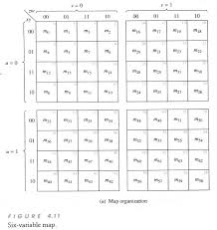
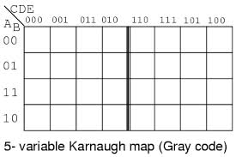
K-map going big!
6 variable k-map

Slide 3
K-map works well upto 4 variable, but when number of variable is more than that trouble starts as it gets difficult to recognize patters leading to wrong selection
Quine McCluskey method or the tabulation method is more systematic and works well for any number of variable

Slide 4
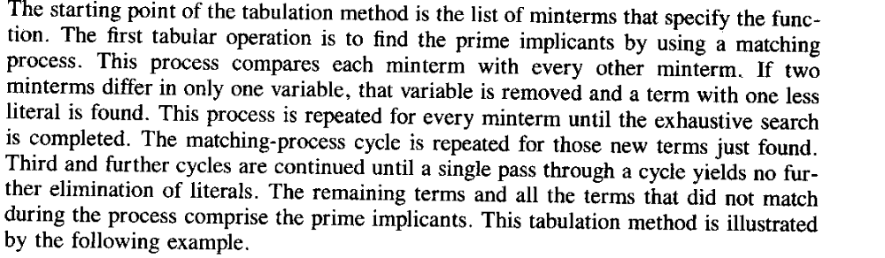

Slide 5
Part 1:Determination of the prime implicant
Forming the tabulation method

Slide 6
Example
F(w,x,y,z)=∑(1,4,6,7,8,9,10,11,15)
F={0001,0100,0110,0111,1000,1001,1010,1011,1111}
Step 1: group the minterms based on the no. of ‘1’s in them
Group A: single ‘1’: {0001,0100,1000}
Group B: two ‘1’s: {0110,1001,1010}
Group C: three ‘1’s: {0111,1011}
Group D:four ‘1’s: {1111}

Slide 7
 | Step 1
1 | 0001
4 | 0100
8 | 1000
6 | 0110
9 | 1001
10 | 1010
7 | 0111
11 | 1011
15 | 1111

Slide 8
Step 2: Any 2 minterm that differ by 1 variable is combined and the different variable is removed.The minterms of a group is compared with minterms of immediate next group (this is because 2 term differing by more than 1 bit cannot match). If 2 matching minterms are found, a ‘√’ (tick) is place besides them

Slide 9
 | Step 1 | Step 2
1 | 0001 | (1,9) | _001
4 | 0100 | (4,6) | 01_ 0
8 | 1000 | (8,9) | 100_
 |  | (8,10) | 10_0
6 | 0110 | (6,7) | 011_
9 | 1001 | (9,11) | 10_1
10 | 1010 | (10,11) | 101_
7 | 0111 | (7,15) | _111
11 | 1011 | (11,15) | 1_11
15 | 1111

Slide 10
Step 3:
Terms from step 2 has 3 options. ‘1’ means variable is unprimed, ‘0’ means variable is primed and ‘_’ means variable is not included in the term.
Now compare terms only if they have ‘_’ in the same position. Once two term match place a ‘√’ beside each

Slide 11
 | Step 1 | Step 2 |  |  | Step 3
1 | 0001 | √ | (1,9) | _001 |  | (8,9,10,11) | 10_ _
4 | 0100 | √ | (4,6) | 01_ 0 |  | (8,9,10,11) | 10_ _
8 | 1000 | √ | (8,9) | 100_ | √
 |  |  | (8,10) | 10_0 | √
6 | 0110 | √ | (6,7) | 011_
9 | 1001 | √ | (9,11) | 10_1 | √
10 | 1010 | √ | (10,11) | 101_ | √
7 | 0111 | √ | (7,15) | _111
11 | 1011 | √ | (11,15) | 1_11
15 | 1111 | √

Slide 12
Prime Implicant
The remaining term ( those without ‘√’) in Step 2 and the terms from Step 3 are called the prime implcants. These terms are candidates suitable for forming the simplified form of the expression
Here prime implicants are:
(1,9) | _001 | X’Y’Z
(4,6) | 01_0 | W’XZ’
(6,7) | 011_ | W’XY
(7,15) | _111 | XYZ
(11,15) | 1_11 | WYZ
(8,9,10,11) | 10_ _ | WX’

Slide 13
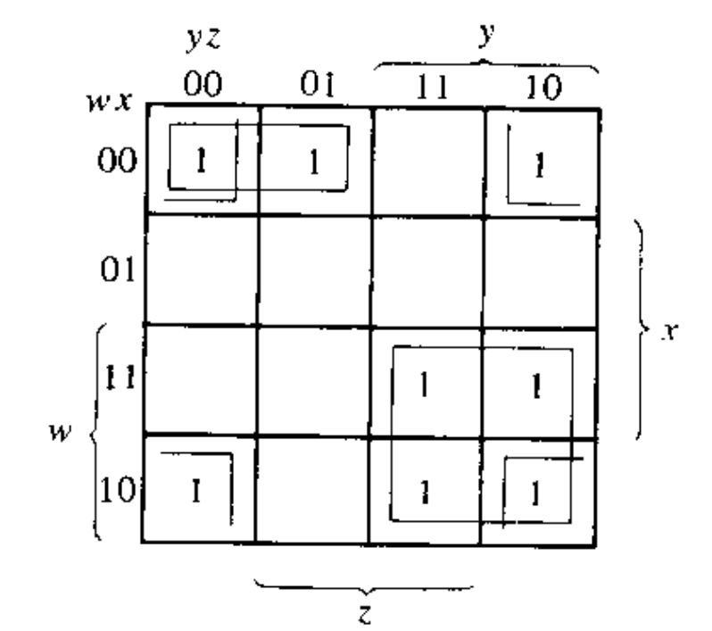
K-MAP using prime implicant shows that it can be further simplified to
F(w,x,y,z)= X’Y’Z+W’XZ’+XYZ+WX’
To achieve further simplification we need to
find the essential prime implicant and
remove the domination rows and dominated
columns.

Slide 14
Part 2: Selection of prime implicants- the setup
Optimizing the tabular method

Slide 15
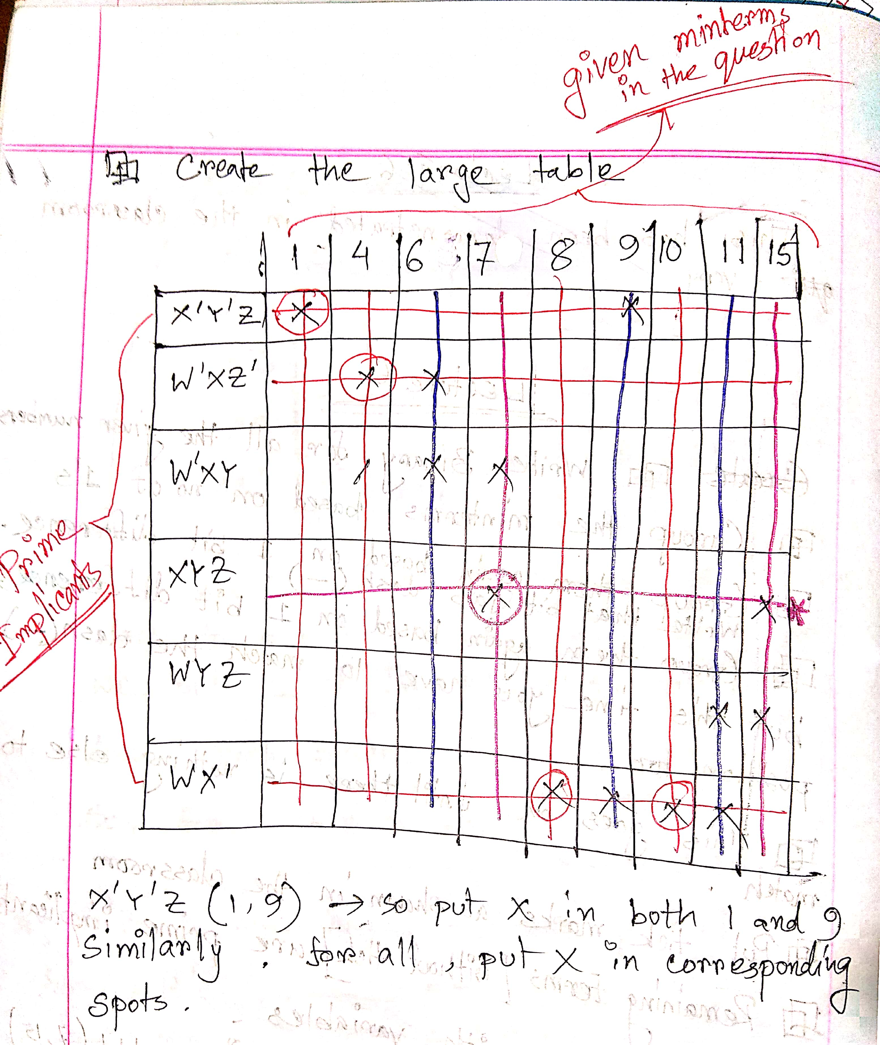

Slide 16
So solution is
F(W,X,Y,Z)= X’Y’Z+W’XZ’+WX’+XYZ
This matched the result from K-MAP!

Slide 17
Example 2
F(a,b,c,d)=∑m(2,5,6,11,12,14,15)+ ∑d(0,3,4)
Note: avoid the don’t care terms in the set-up(optimization) phase.

Slide 18
 | Step 1 | Step 2 |  |  |  | Step 3
0 | 0000 | √ | (0,2) | 00-0 | √ | (0,2,4,6) | 0--0
 |  |  | (0,4) | 0-00 | √ | (0,4,2.6) | 0--0
2 | 0010 | √ | (2,3) | 001- |  | (4,6,12,14) | -1-0
4 | 0100 | √ | (2,6) | 0-10 | √ | (4,12,6,14) | -1-0
 |  |  | (4,5) | 010-
 |  |  | (4,6) | 01-0 | √
 |  |  | (4,12) | -100 | √
3 | 0011 | √ | (3,11) | -011
5 | 0101 | √ | (6,14) | -110 | √
6 | 0110 | √ | (12,14) | 11-0 | √
12 | 1100 | √
11 | 1011 | √ | (11,15) | 1-11
14 | 1110 | √ | (14,15) | 111-
15 | 1111 | √

Slide 19
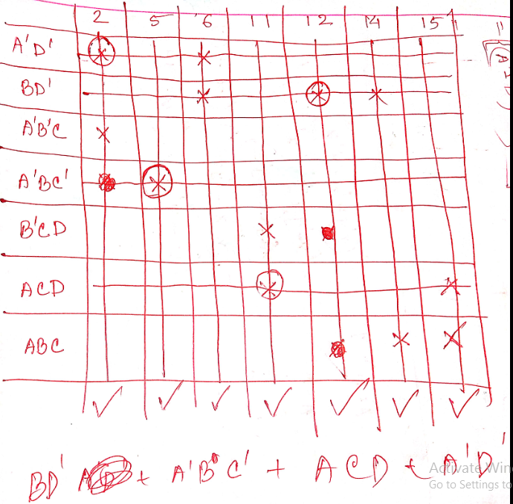
Don’t care terms are avoided here.

Slide 20
So solution is
F(W,X,Y,Z)= BD’+A’BC’+ A’D’+ ACD

Slide 21
Try it yourself
F(w,x,y,z)=∑(0,1,2,8,10,11,14,15)

Slide 22
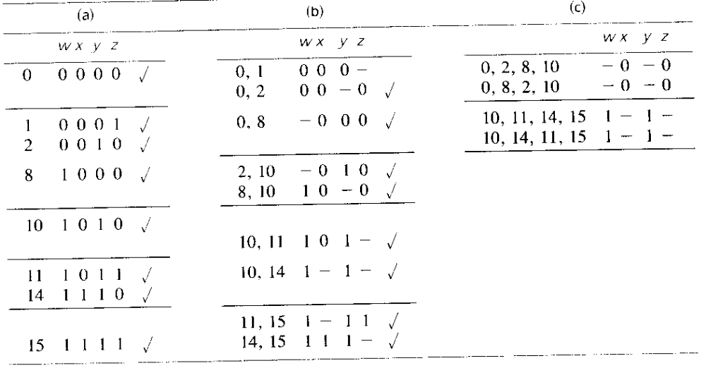
Solution

Slide 23
Prime implicant optimization
F=w’x’y’+x’z’+wy
All rows have single ‘1’, so all are essential prime implicant hence no further optimization can be done. Answer is:
F=w’x’y’+x’z’+wy
 | W’X’Y’ | X’Z’ | WY
0000 | 1 | 1
0001 | 1
0010 |  | 1
1000 |  | 1
1010 |  | 1 | 1
1011 |  |  | 1
1110 |  |  | 1
1111 |  |  | 1

